Slide 1
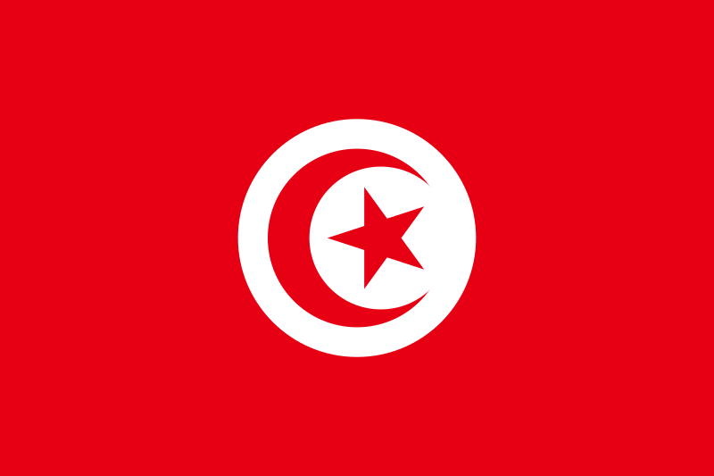
Tunisia
Facts,history and more
Made by Nick (:

Slide 2
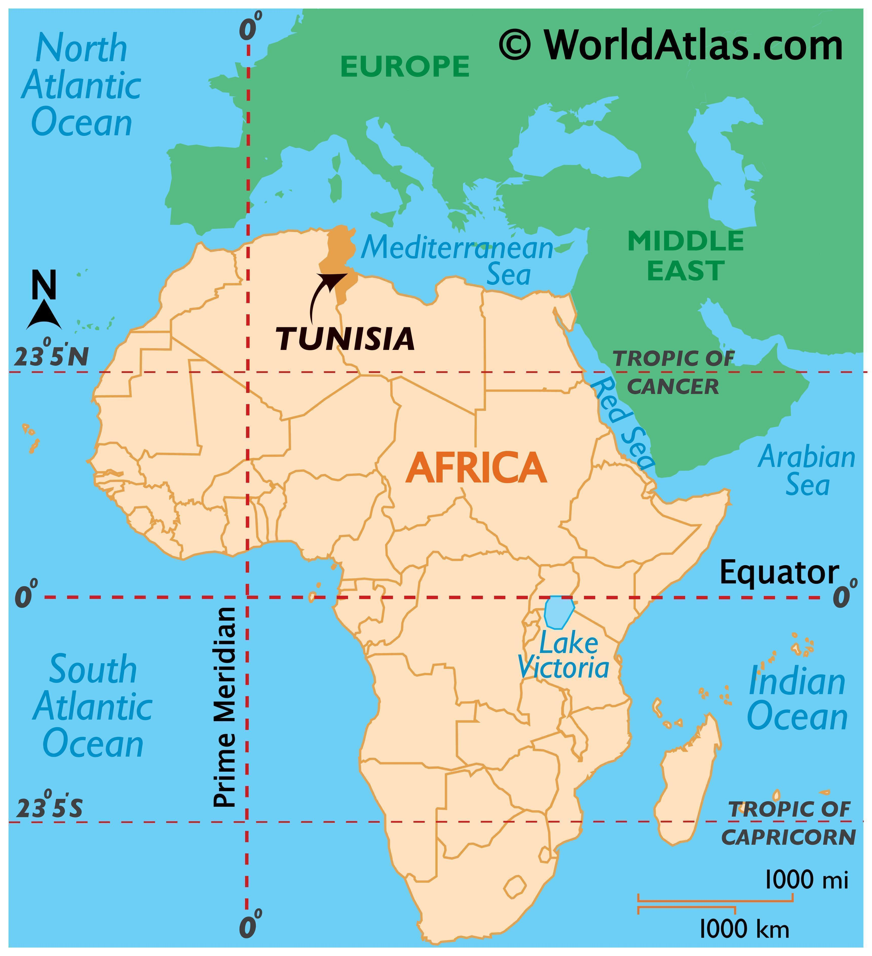
Tunisia is located in the north of Africa and borders Algeria to the west and southwest, Libya to the southeast, and the Mediterranean Sea to the north and east.

Slide 3
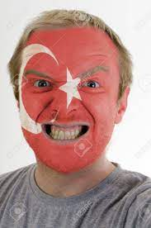
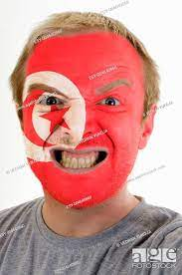
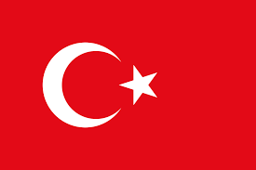
Allot of people ask Why does the flag of Tunisia look the same as turkeys?
No you did!
You copied me!

Slide 4
Answer: Because its based on the Turkish flag.
Get your own ideas!
The Tunisian flag was created in 1827.

Slide 5
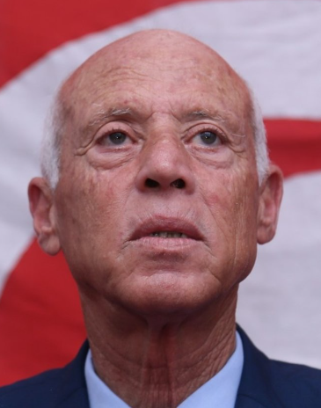
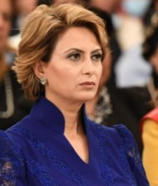
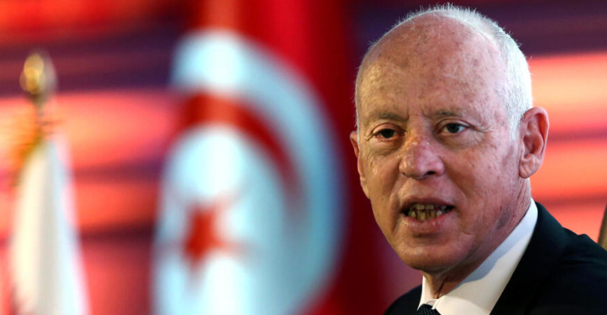
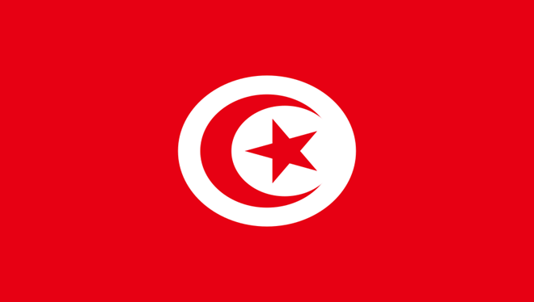
The president of Tunisia is kais saied he was born on February 22, 1958 (age 65 years), at Tunis, Tunisia
His mother is Moncef Saied and his father is Zakia Bellagha.
Ichraf Chebil, the wife of Kais Saied.
He earns only €5,025.00 per year.
He has 3 children and they are named Sarah,Mouna and Amrou and he is married to Ichraf Chebil.

Slide 6
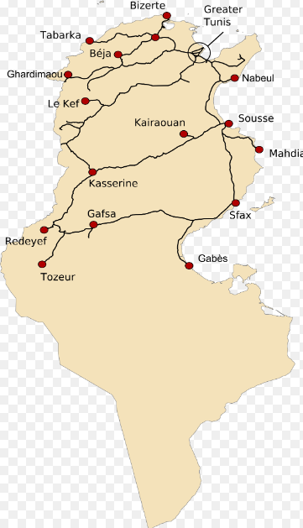
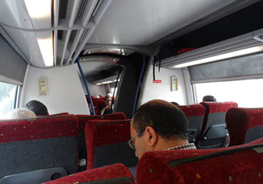
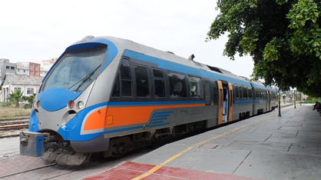
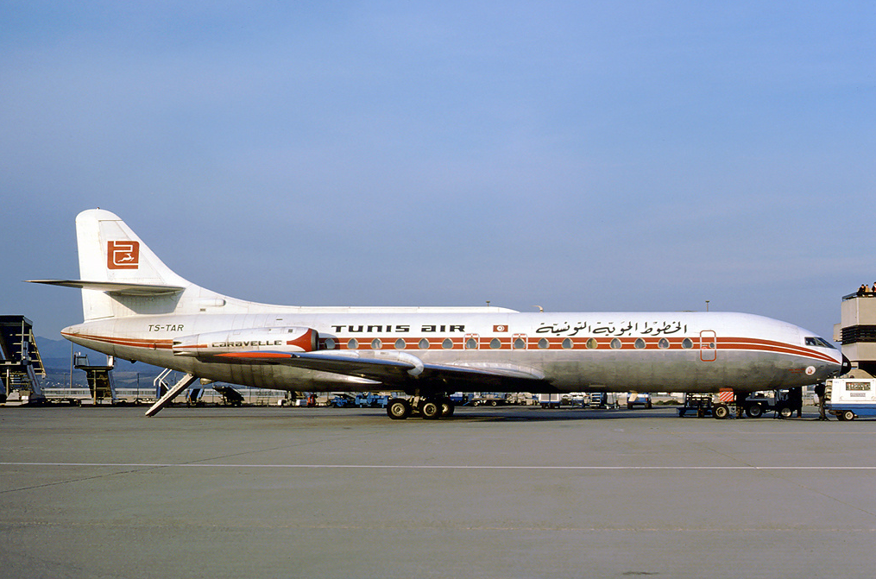
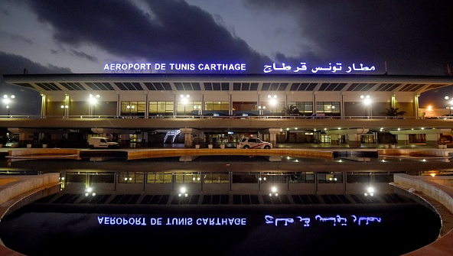
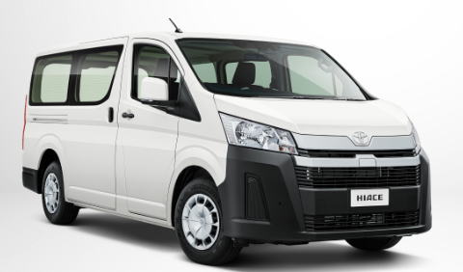
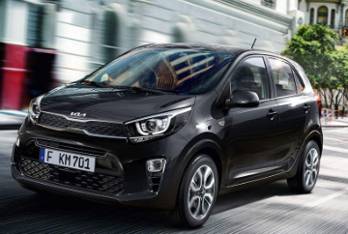
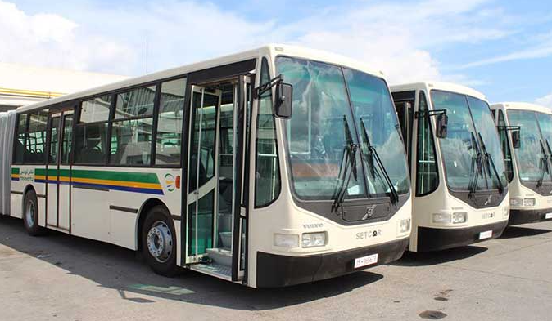
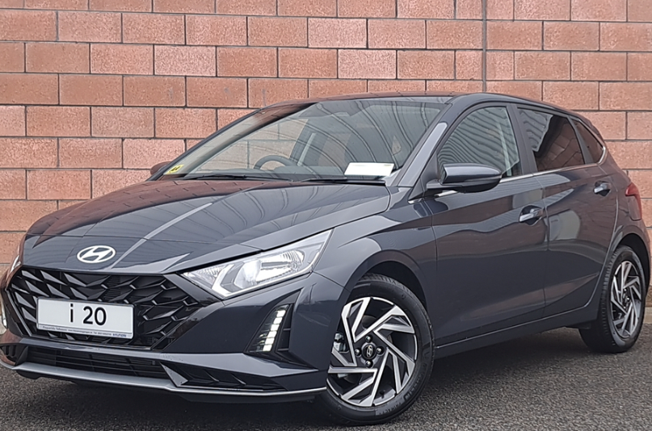
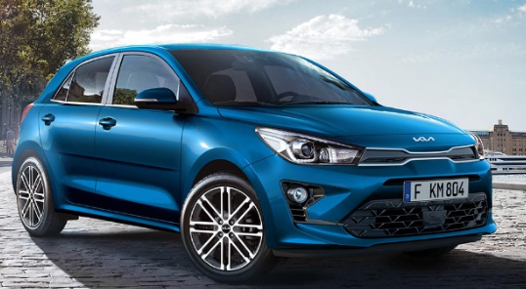
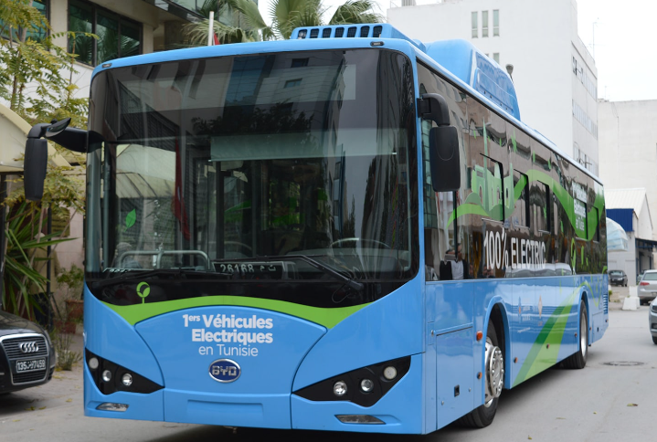
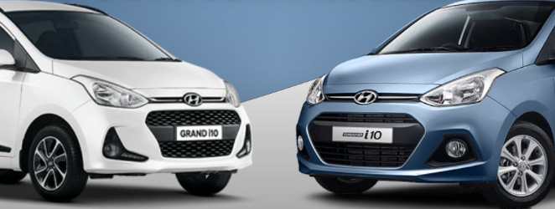
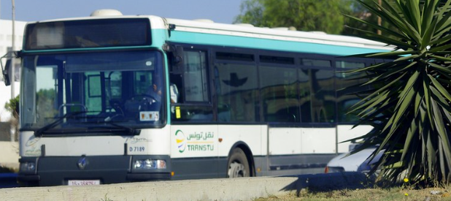
Transportation
Trains
Aircraft
NOW
THEN
Inside a Tunisian train.
A Tunisian train.
Railroad map of Tunisia.
There are no railroads in the south of Tunisia only in the north.
TUNISAIR is the airline of Tunisia
It was founded on October 21 1948.
Cars
Top 5 most cars sold in Tunisia
5th Place: Toyota Hiace.
4th Place: Kia Picanto.
3rd Place: Hyundai i20.
2nd Place: Kia Rio SP.
1st Place: Hyundai Grand i10.
International airport of Tunisia.
Bus
First 100% Electric bus in Tunisia.
Busses are the most popular way to get around in Tunisia.

Slide 7
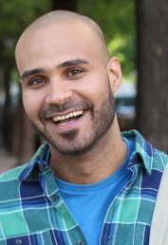
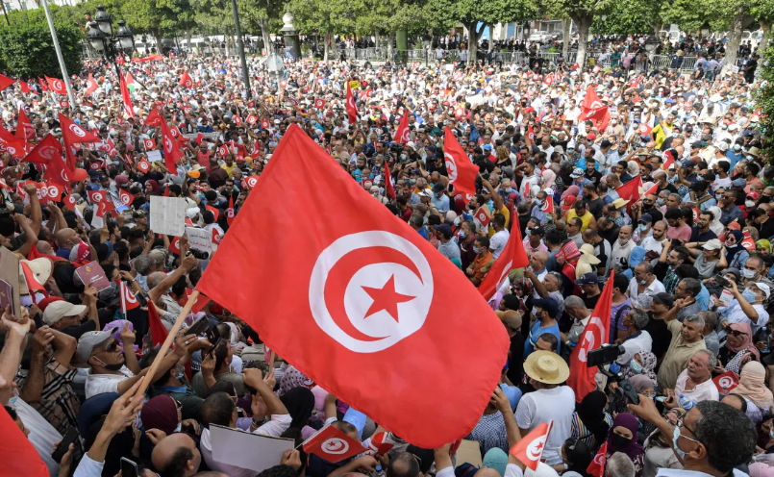
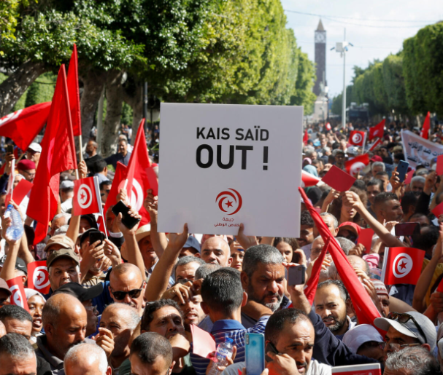
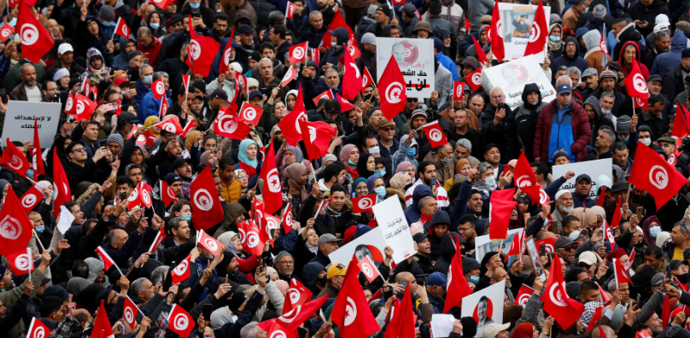
People
Average Height in Tunisia
In 2023 there was a population of 12,458,223.
There are more women than men in Tunisia.
The average age of people in Tunisia is 32.3 Years old.
Lots of people protest about many different things
Tunisian Women
Tunisian Man

Slide 8
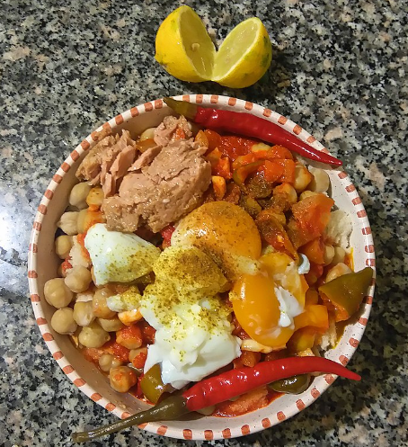
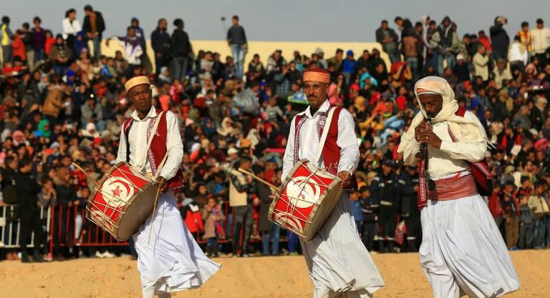
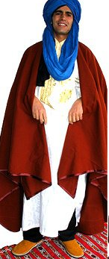
Tradition
Couscous, called kosksi, is the national dish of Tunisia, and can be prepared in many ways. It is cooked in a special kind of double boiler called a kiska:s in Arabic or couscoussière in French.
Tunisian culture is more than 3 thousand years old
Sweet or colorful dishes symbolize religious holidays, usually in addition to couscous.
Each December Tunisia has a festival called International Festival of the Sahara
Traditional outfits of Tunisia

Slide 9
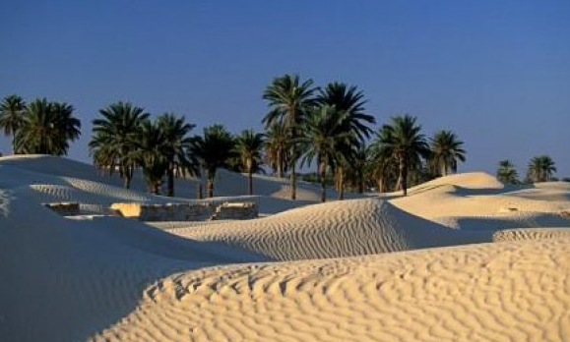
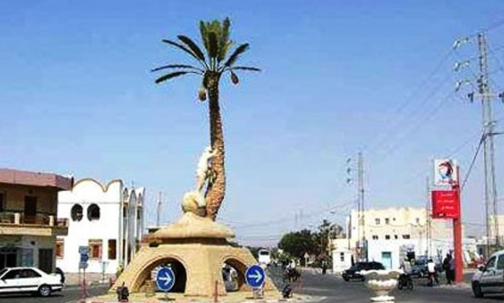
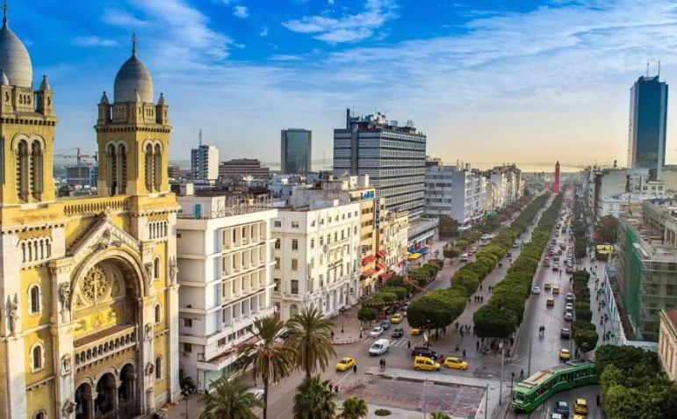
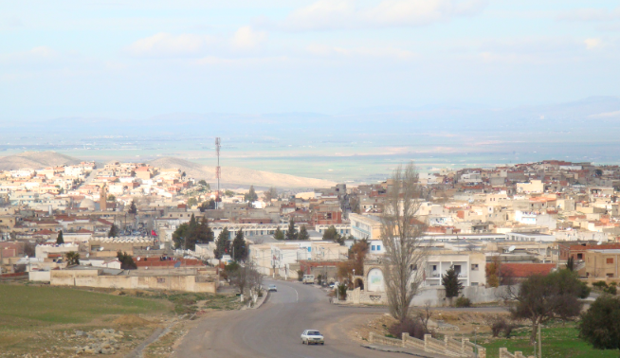
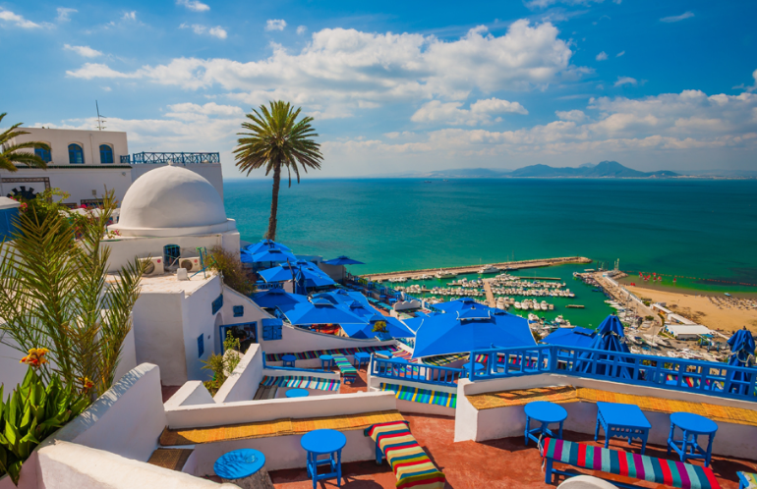
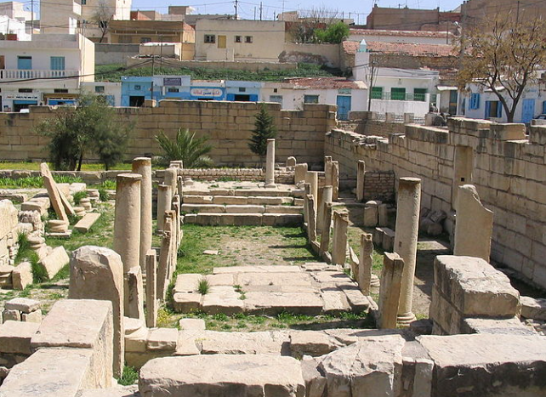
Places
Kebili
Tunis is the capital of Tunisia
Tunis has the biggest population in Tunisa
Thala is the coldest city in Tunisia
Kebili is the hottest city in Tunisia
Tunis
Thala

